Slide 1



Managing Files and Folders
A systematic guide to understanding computer file systems, organizing digital data, and performing essential file operations.
Made by Mandar Bodhare
Class 10th C

Slide 2




Why File Management Matters
The Wardrobe Analogy
The Computer File System
Storing information on a computer is like organizing clothes in a wardrobe. Placing clothes systematically in separate drawers saves time and energy, whereas throwing everything into one drawer causes chaos and delay.
If files are saved randomly on a computer, finding them later wastes significant effort. The Operating System provides a File System to logical organize and name data for effortless storage and retrieval.

Slide 3

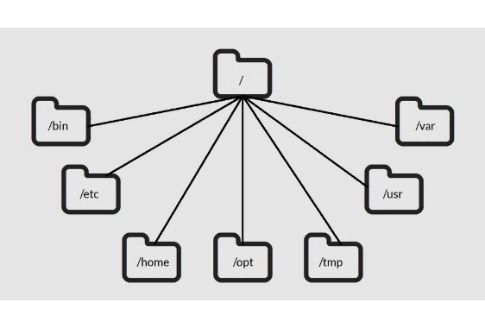
Understanding the File System
Hierarchical File Architecture
The File System is a layer of system software responsible for organizing and managing stored data. Most OS (Windows, macOS, Unix) use a tree-like hierarchy:
Root Folder: The topmost directory containing all other elements.
Folders (Directories): Organizational containers used to group related files.
Sub-folders: Folders nested inside other folders to create refined levels.

Slide 4






Creating Files and Folders
1. Context Menu
2. Choose 'New'
3. Name & Confirm
Right-click once on any blank area of the Desktop or inside File Explorer to open the shortcut context menu.
Hover over New and select Folder or choose a file type (MS Word, Excel, Text Document, etc.).
Type a descriptive name for your new item at the cursor location and press the Enter key to save.

Slide 5
Renaming Files and Folders
Context Menu Method: Right-click on the file/folder, select Rename from the menu, type the new name, and press Enter.
This PC Ribbon Method: Open This PC, select the item, and click the Rename button located in the Organize group under the Home tab.
Keyboard Shortcut: Select any file or folder and press the F2 key to quickly edit its name.
Pro Tip - Batch Renaming: Select multiple files at once, choose rename, and type a single name. Windows will automatically append sequential numbers, e.g., Project (1), Project (2).

Slide 6


Deleting Files and Folders
Quick Deletion Methods
Two Deletion Options
To remove unwanted items from your computer:
When deleting an item, you can choose:
Select the file/folder and press the Delete key.
Recycle: Moves the item to the Recycle Bin so it can be safely restored later if needed.
Right-click the item and choose Delete.
Permanently Delete: Erases the file completely from the computer disk (Shift + Delete).
Use This PC → Home Tab → Organize Group → Delete.

Slide 7



Recycle Bin Operations
Restore Single Item
Restore All Items
Empty Recycle Bin
Open Recycle Bin, select the item, and click Restore the selected items under Recycle Bin Tools tab to return it to its original location.
Click Restore all items on the top ribbon toolbar to instantly retrieve all deleted files back to their previous folder paths.
Right-click the Recycle Bin icon on the desktop and click Empty Recycle Bin to permanently remove all items and free up hard disk space.

Slide 8



Moving vs. Copying Data
Moving a File / Folder
Copying a File / Folder
Moving shifts the file from its original location (source) to a new location (destination). The file is completely removed from the original place.
Copying creates an exact duplicate copy of the selected file or folder in the destination folder, while keeping the original intact at the source.

Slide 9
Methods to Move and Copy
Ribbon Toolbar Method: Open This PC, choose your file, and click Move to or Copy to from the Organize group on the Home tab. Choose the destination path.
Context Menu Method: Right-click the file and select Cut (to move) or Copy (to duplicate). Navigate to the target folder, right-click blank space, and choose Paste.
Keyboard Shortcut Method: Select file → Press Ctrl + X (Move) or Ctrl + C (Copy) → Go to target location → Press Ctrl + V (Paste).

Slide 10
Essential Shortcuts Summary
Action | Shortcut / Method | Result
Rename Item | F2 or Right-Click → Rename | Edits the current file/folder label
Move Item | Ctrl + X then Ctrl + V | Relocates item (Cut & Paste)
Copy Item | Ctrl + C then Ctrl + V | Creates a duplicate copy
Temporary Delete | Delete key | Sends item to Recycle Bin
Permanent Delete | Shift + Delete | Bypasses Recycle Bin completely

Slide 11

Key Best Practices
Golden Rules for File Storage
Following structured file management ensures smooth workflow and reliable storage:
100%
Always use clear, meaningful folder names (e.g., Math_Homework_2026).
Group related files inside sub-folders to maintain logical hierarchy.
Organized Digital Workspace
Periodically empty your Recycle Bin to clear system storage.

Slide 12
Questions & Review
Thank you for participating! You now master the fundamentals of managing files and folders effectively.
Unit 3: Information and Communication Technology Skills-II

Slide 13

Image Sources
https://www.linuxtrainingacademy.com/wp-content/uploads/2014/03/linux-folders.jpg
Source: www.linuxtrainingacademy.com

